Slide 1
UNIT 1:
Threats to sustainable fisheries

Slide 2
Internal threats
Activity 1.1: List three (3) potential threats to fisheries.
INTERNAL THREATS
Overfishing –
  Retained species (target & by-product)
  Bycatch species
  Growth overfishing
  Recruitment overfishing
Activity 1.2: Discuss local examples of fishing impacts using a timeline.

Slide 3
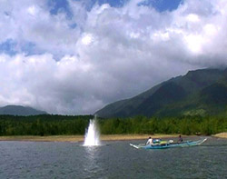
Internal threats
Destructive fishing – explosives, poisons, trawling.
Ecosystem impacts – see ecosystem foodweb (next slide)

Slide 4
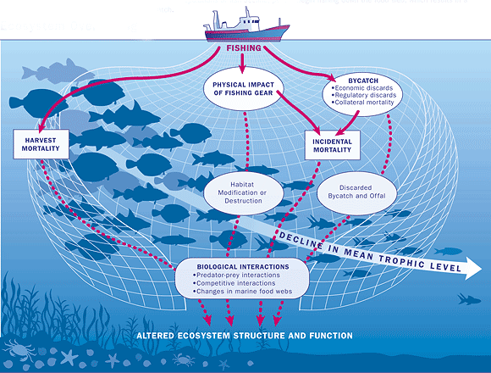
Ecosystem impacts
Activity 1.2: Discuss local examples of fishing impacts using a timeline.

Slide 5
External threats
EXTERNAL THREATS
Downstream (catchment) impacts – farming, mining, agriculture, coastal development.

Slide 6
External threats cont.
Illegal foreign fishing
Climate change
  Direct effects on species
  Indirect effects through habitat modification
  Changes include temperature, rainfall, ocean pH, currents, sea level
Externally sourced pollutants
  Pollution from other catchments/countries
  Discarded nets (ghost fishing)
  Other marine debris

Slide 7
Local threats
Activity 1.3: Using the examples of local fishery threats identified earlier, rank them from most dangerous to least.

Slide 8
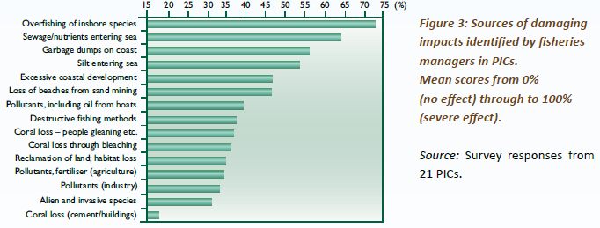
Key threats in PICTs

Slide 9
Threats
Shifting ecological baselines
  What is a healthy ecosystem?
  Each generation has a different ‘baseline’
  Historical knowledge important
DVD – Plenty more fish in the sea?
Consequences of threats to fisheries
  Altered ecosystem structure and functioning
  Altered species composition
    Social and economic impacts
Must therefore manage ALL parts of the ecosystem

Slide 10
Threats
Activity 1.4: In groups write down some local examples of social, economic and cultural consequences of negative fishery impacts? One person from each group to present back to the class.

Slide 11
Unit review
THREATS TO FISHERIES
Internal threats
External threats
Threats impact on the entire ecosystem
Shifting ecological baselines

Slide 12
Unit review
15 minute personal review: unit review, students to review main concepts of unit in the course notes, contribute any new words (new to them) to their own personal glossary in the back of their notebook (local language equivalent terms should also be recorded where possible)
Homework
Interview your parents/grandparents/older neighbour about shifting baselines and their past fisheries experience compared with today. (Report back the next class)

